Slide 1

CEIR TRC Overview -Training Manual

Slide 2

Agenda
TRC Definition and Overview
Assumptions
Features
Registration
Dashboard
Type Approval
Grievance
Profile Management

Slide 3
TRC - Definition
TRC stands for Telecom Regulatory of Cambodia
TRC has the responsibility of regulating the sale of SIM based devices in Cambodia
All importers has to take permission from TRC before importing SIM based devices
TRC issue a certificate to importers, once the permission is granted to import.

Slide 4
Overview
TRC personnel has to register using DMC Home Portal
As part of registration process, TRC personnel will receive the username and password which can be then used to login to the CEIR Portal
Once logged into the CEIR portal, TRC personnel can perform following operations
Manage Type Approval
Grievance Management
Profile Management
TRC personnel can see the status of ongoing activity through the Dashboard feature
Email Notification to keep track of the status of various operations

Slide 5
Assumption
TRC will provide Type approved SIM based devices if possible.
Regulation is already in place for importers to take permission from TRC to import SIM based devices
Regulation has to be in place for rejecting the device upload based on the Invalid TAC from the importer which are not approved by TRC

Slide 6
Registration – TRC
A TRC personnel would register on the CEIR Portal
TRC is a government body.
TRC personnel would provide information about his reporting manager as well

Slide 7
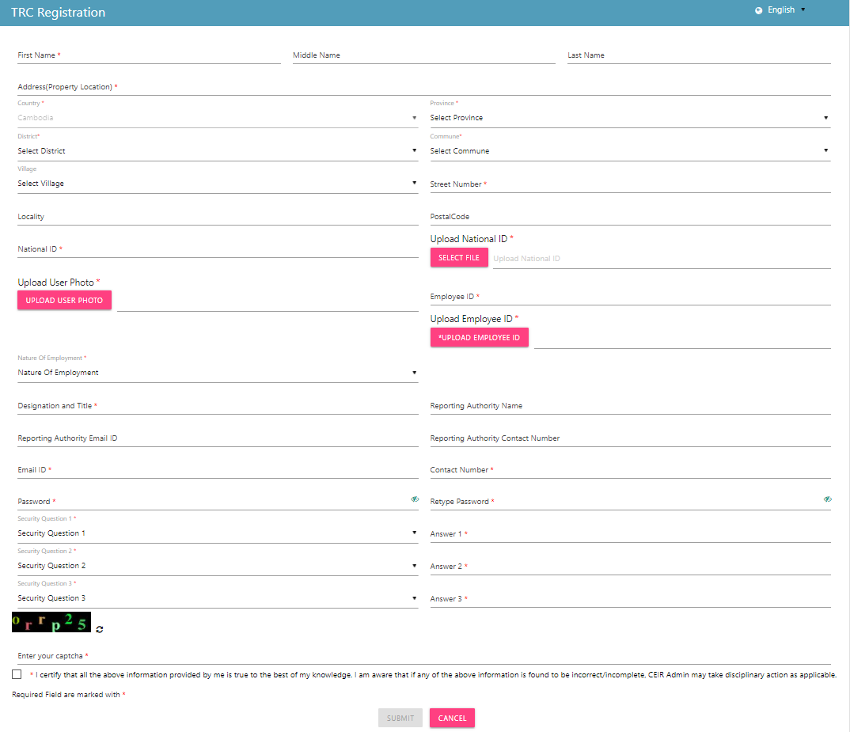
Registration – TRC (Form)

Slide 8
Dashboard – TRC
The panel on the left displays all the operations that a TRC personnel can perform.
The work area on the right-hand side displays the status of all the features
Type Approval requested by the TRC personnel
Total Grievances raised by the TRC personnel
The work area also displays notifications on the TRC personnel raised feature requests.
The top right panel has download option where the TRC personnel can download the User Manual for reference.
TRC personnel can also change their profile language to Khmer.

Slide 9
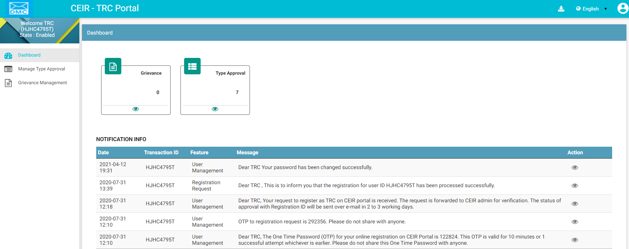
Dashboard – TRC
Download User Manual
Work Area
Left Panel
All features status
Edit Profile
Language Change
Notifications

Slide 10
Type Approved – TRC
TRC personnel has an option to upload TAC approved by them in the CEIR portal
CEIR admin approve the TAC as uploaded by TRC
TRC Type approved TAC become one of the database on which policy is implemented.

Slide 11
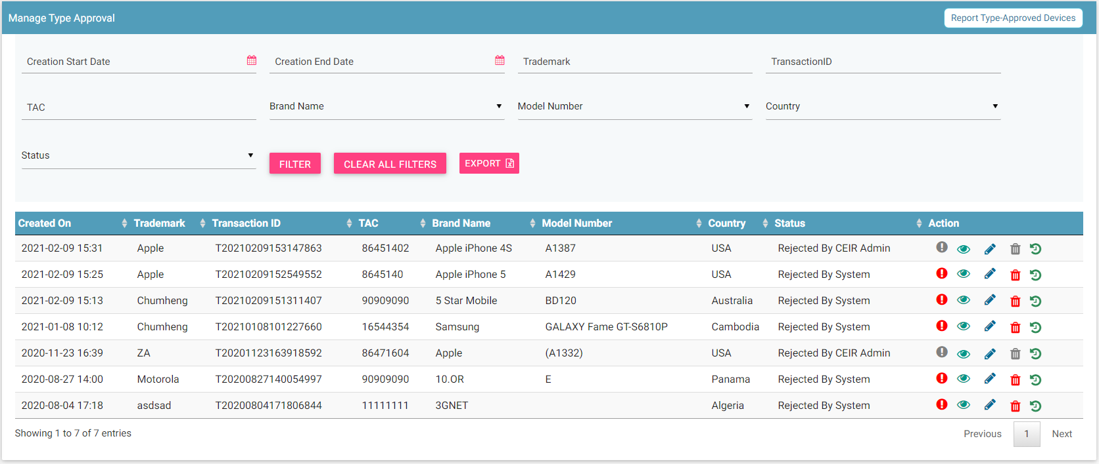
Type Approval – TRC
Report Type Approval
Filters
Export
Action like View, Edit & Delete
View All requests

Slide 12
Grievance – TRC
As a TRC personnel, you can register grievances when there is a problem in the portal.
For example, there could be situations when the registration feature is not working or there could be some issues with the TAC upload.

Slide 13
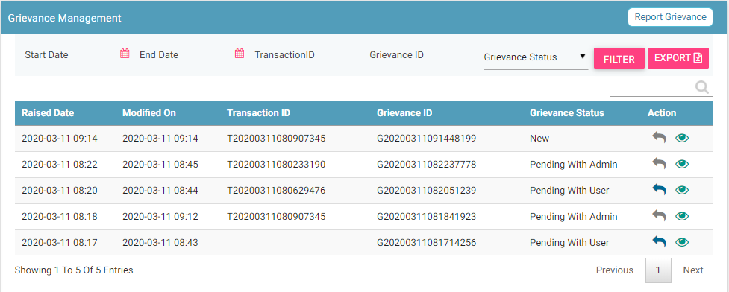
Grievance – TRC
Report
Filters
Export
View details
Action like View, Reply

Slide 14
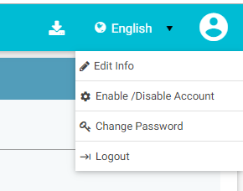
Profile Management – TRC

Slide 15
Queries

Slide 16
Thank You

